Slide 2
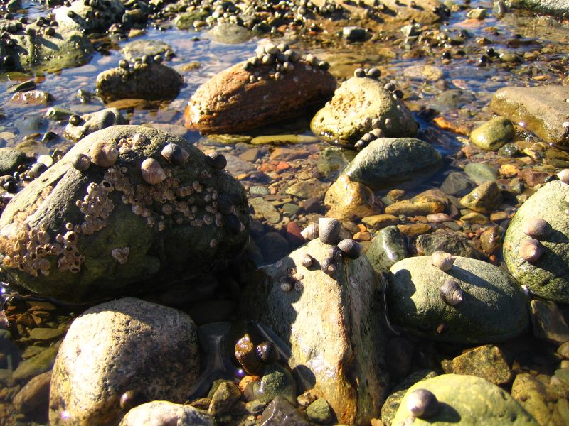
Notes:
Photo Credit – comeonworkitout, flikr : Barnacles! One of Charles Darwin’s favourite organisms

Slide 3
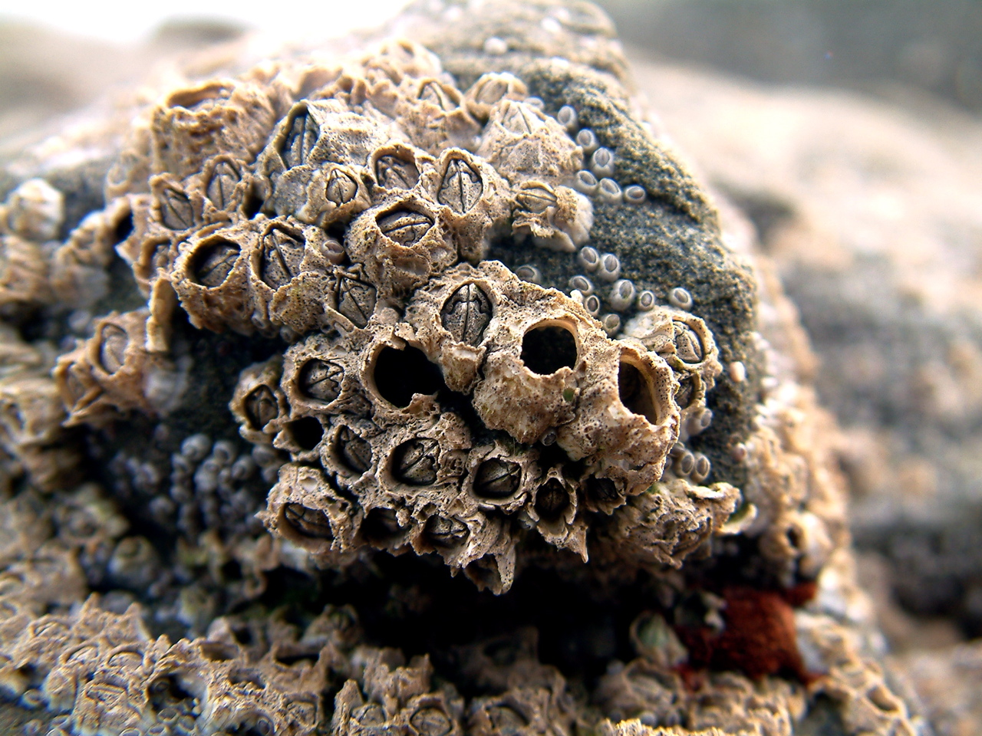
Notes:
Photo Credit – Oli
Possible questions: why are these barnacles closed up? (because tide it out and they would dry out).

Slide 4
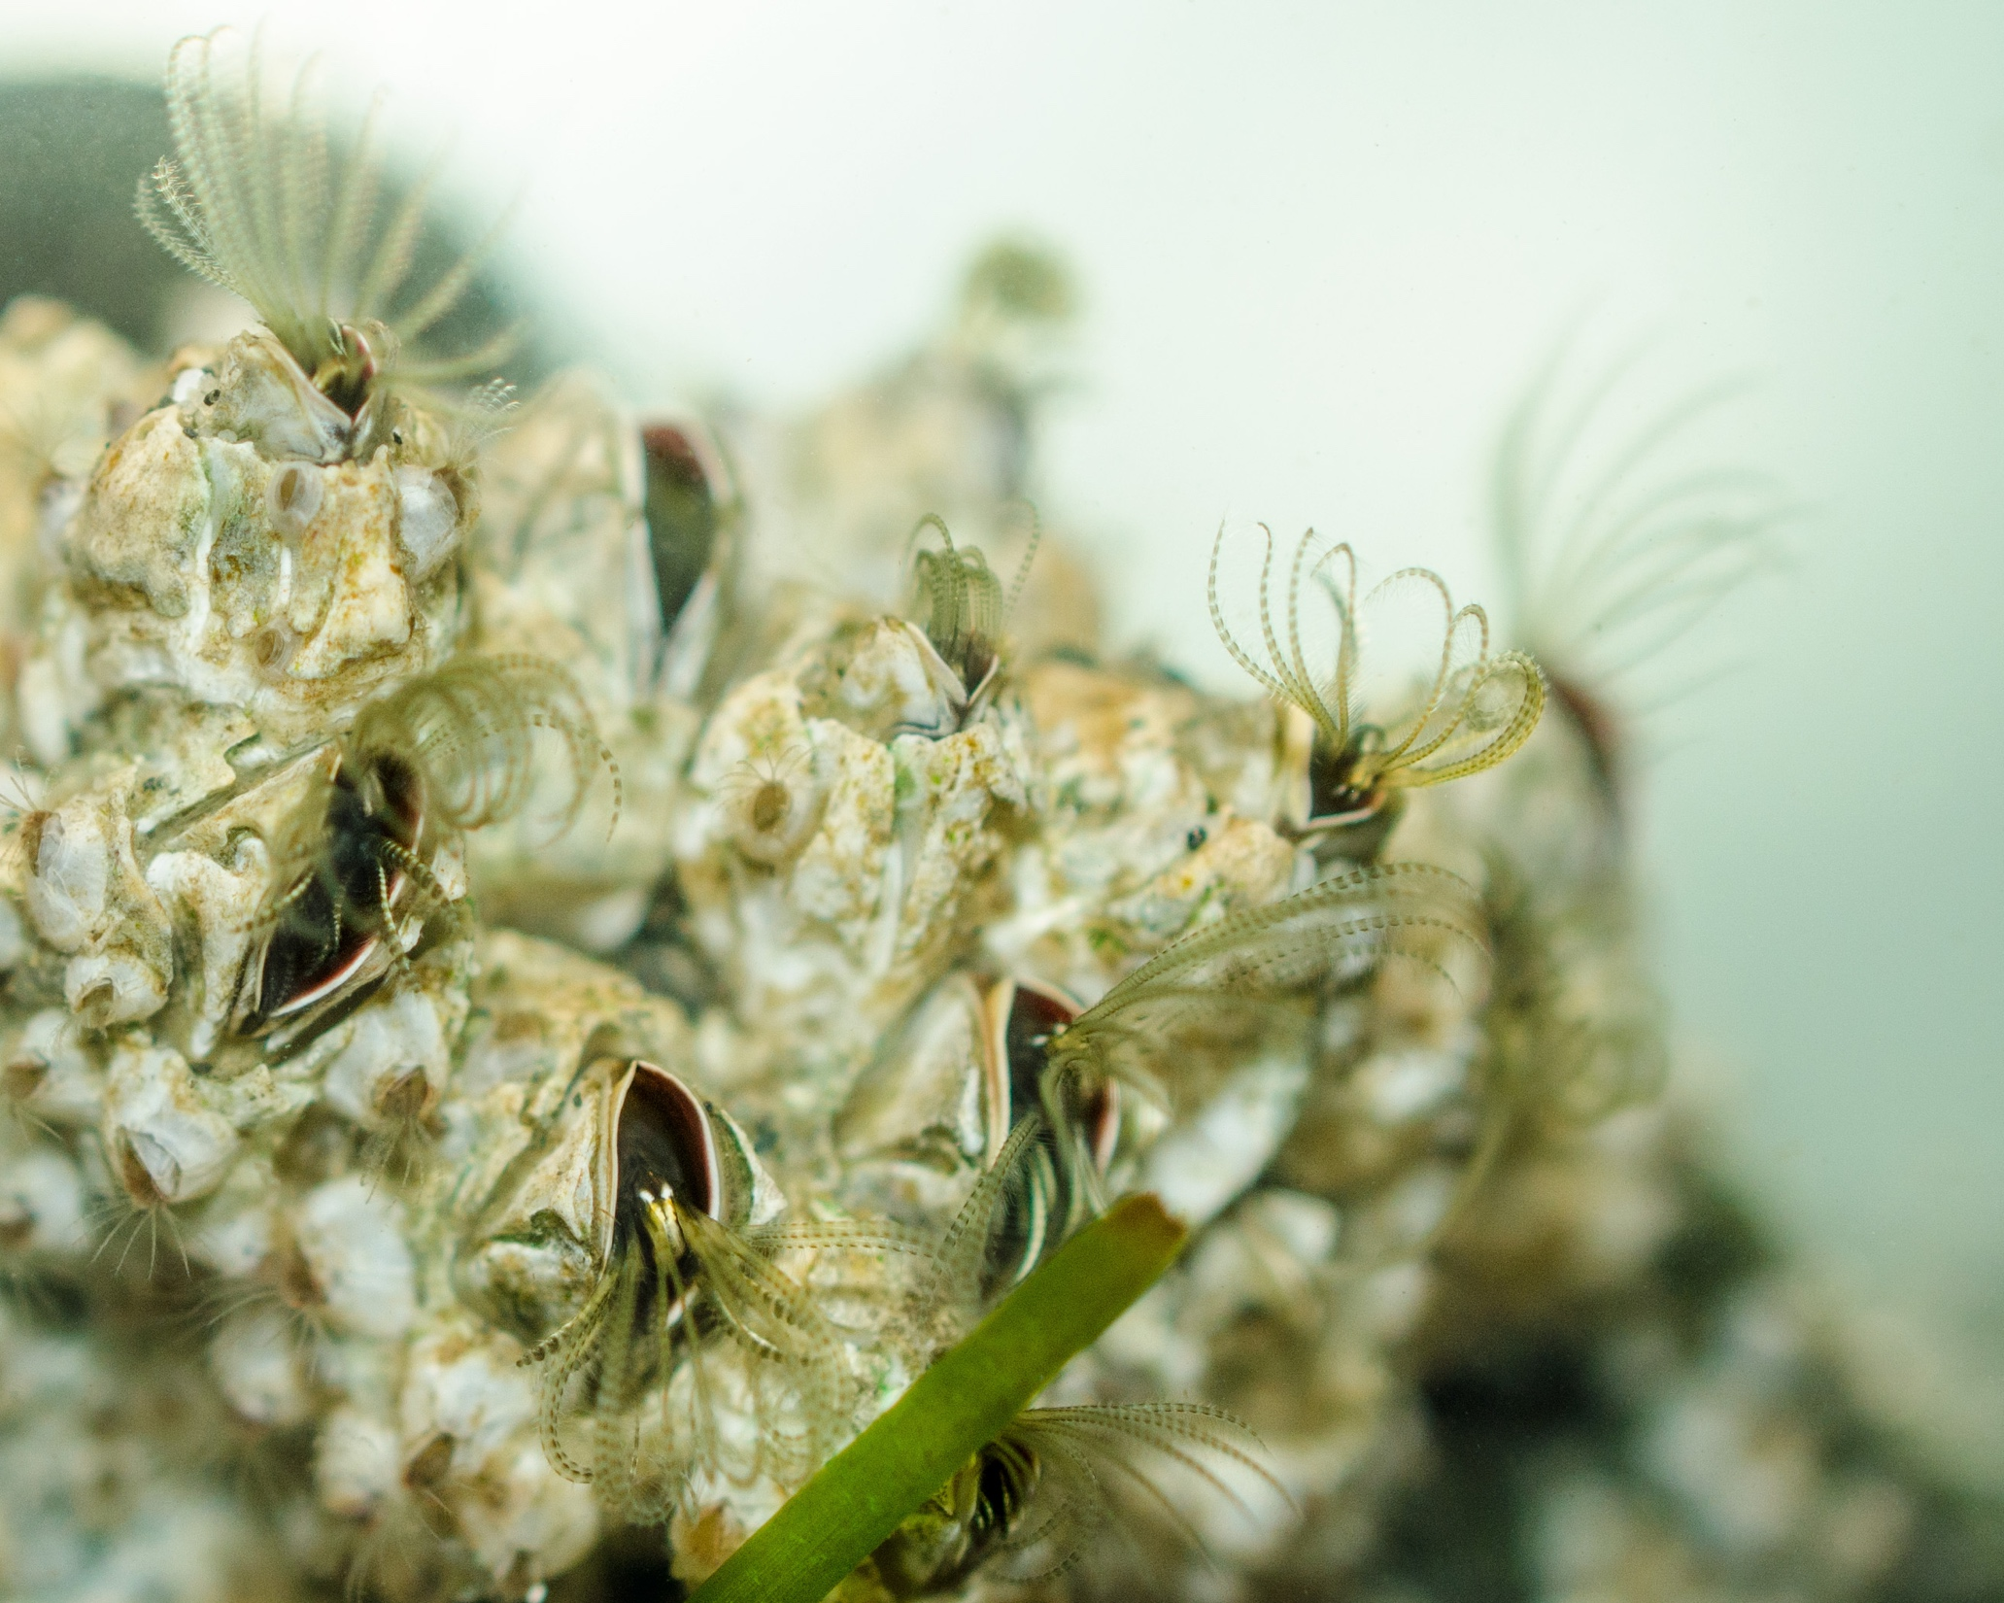
Notes:
Photo Credit – Susannah Anderson: Possible questions: What do you think these barnacles are doing? And what are those frondy structures? (the barnacles are feeding by waving the fronds through the water to try and catch food particles).

Slide 5
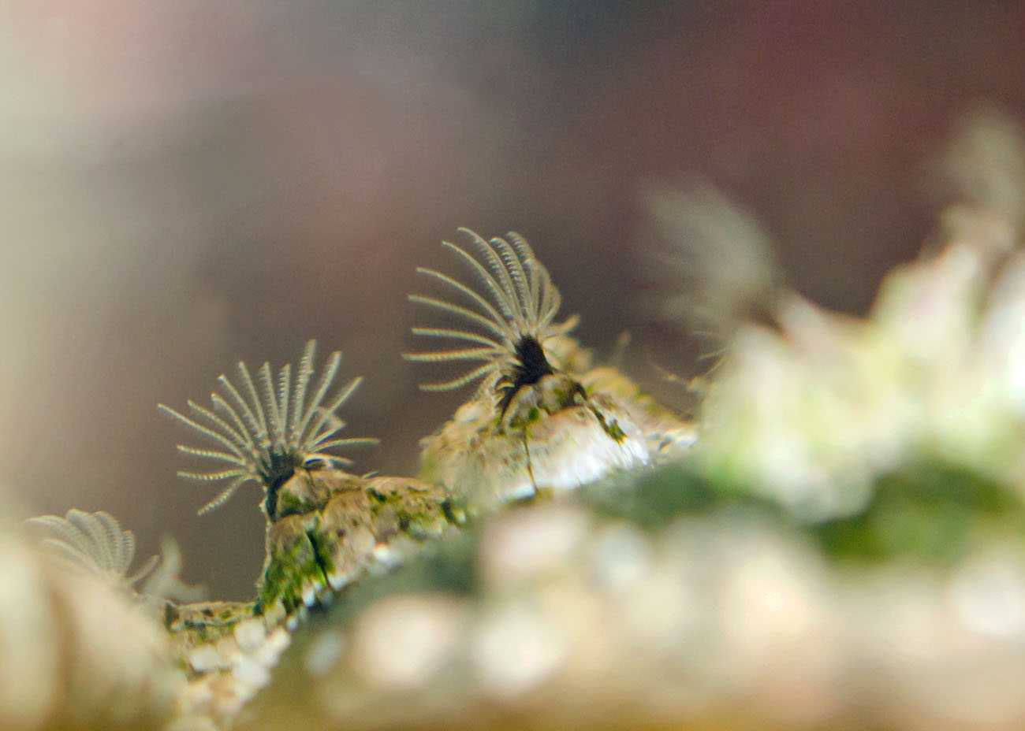
Notes:
Photo Credit – Susannah Anderson: The “fronds” are actually legs – think of a barnacle as being like a little shrimp, lying on its back in its little home, waving its legs in the water to feed.

Slide 6
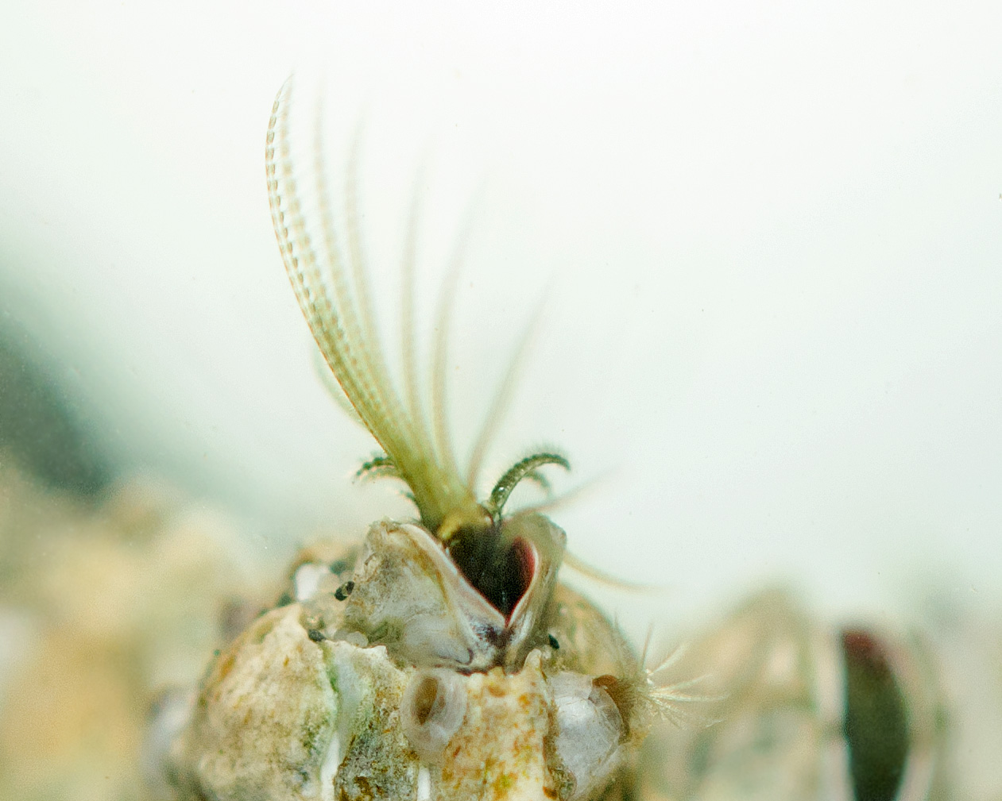
Notes:
Photo Credit – Susannah Anderson. Barnacles have the longest penis to body ratio in the animal kingdom: the penis can be 50x the length of the body – why do you think this is? (it allows male barnacles to mate with neighbouring female barnacles without having to move or leave the shelter of their shells) If a barnacle was the size of a man – it’s penis would be as big as Nelson’s Column…

Slide 7
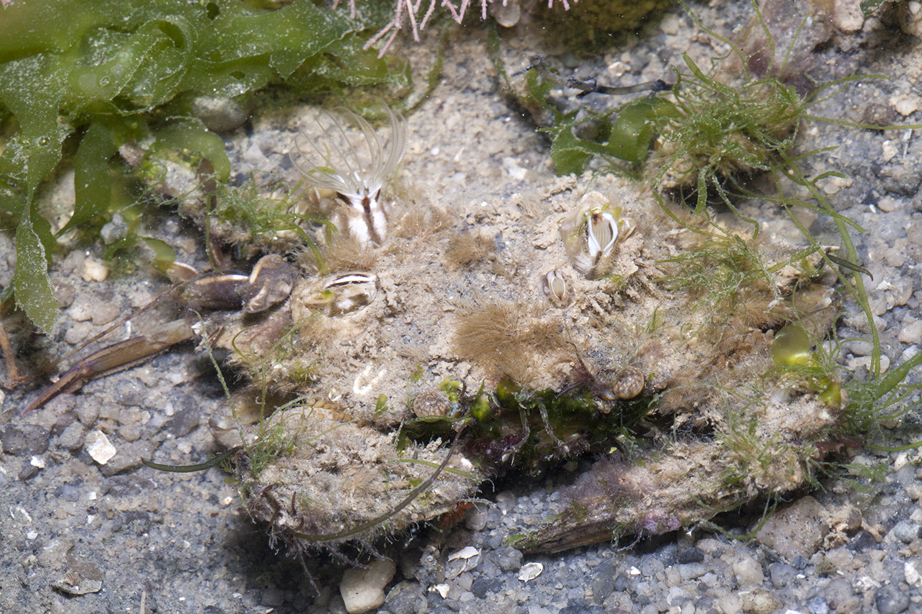
Notes:
Photo Credit – Budak
Barnacles on swimming crab

