Slide 1
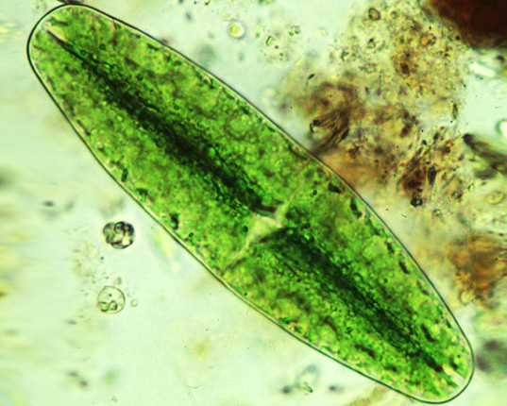
Notes:
Questions/answers to go with pictures: Any idea what this is? (it’s not life size!). It’s an algae that lives in the sea, a phytoplankton

Slide 2
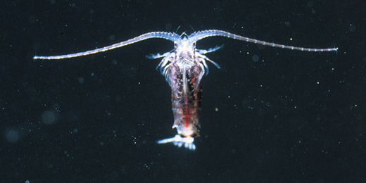
Notes:
Any idea what this is? No? It’s a copepod. It also lives in the sea. Also not life size. Guess what it eats. That’s right! Phytoplankton.

Slide 3
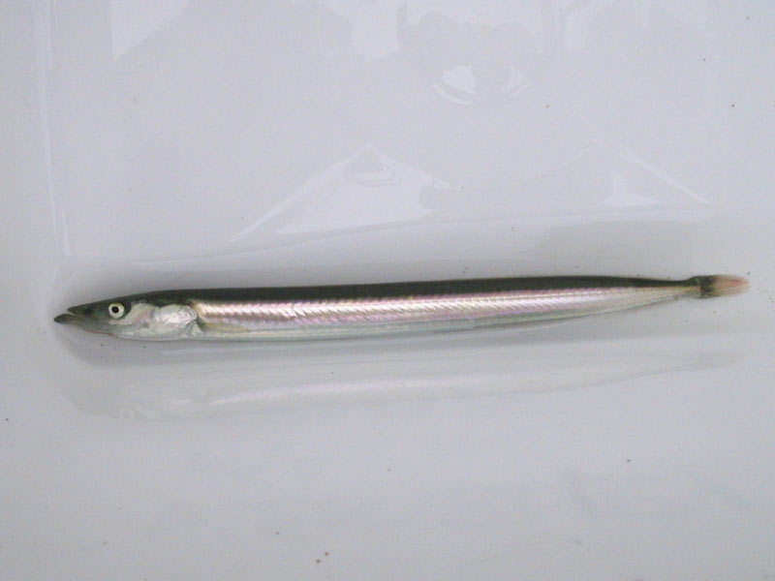
Notes:
And this one? It’s a sand eel. Lives in the sea. Eats…? Copepods!

Slide 4
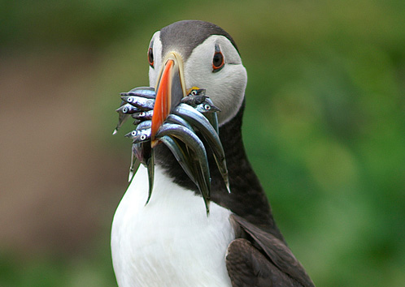
Notes:
Yay, a puffin. But what’s it eating? Yes, sandeels – how many can it hold at one time? It’s bringing them back to its burrow to feed the pufflings.

Slide 5
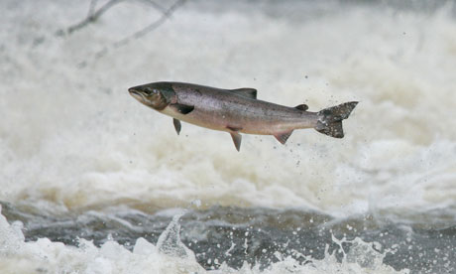
Notes:
This? A salmon. Doesn’t eat puffins, or pufflings – it’s another predator of sandeels.

Slide 6
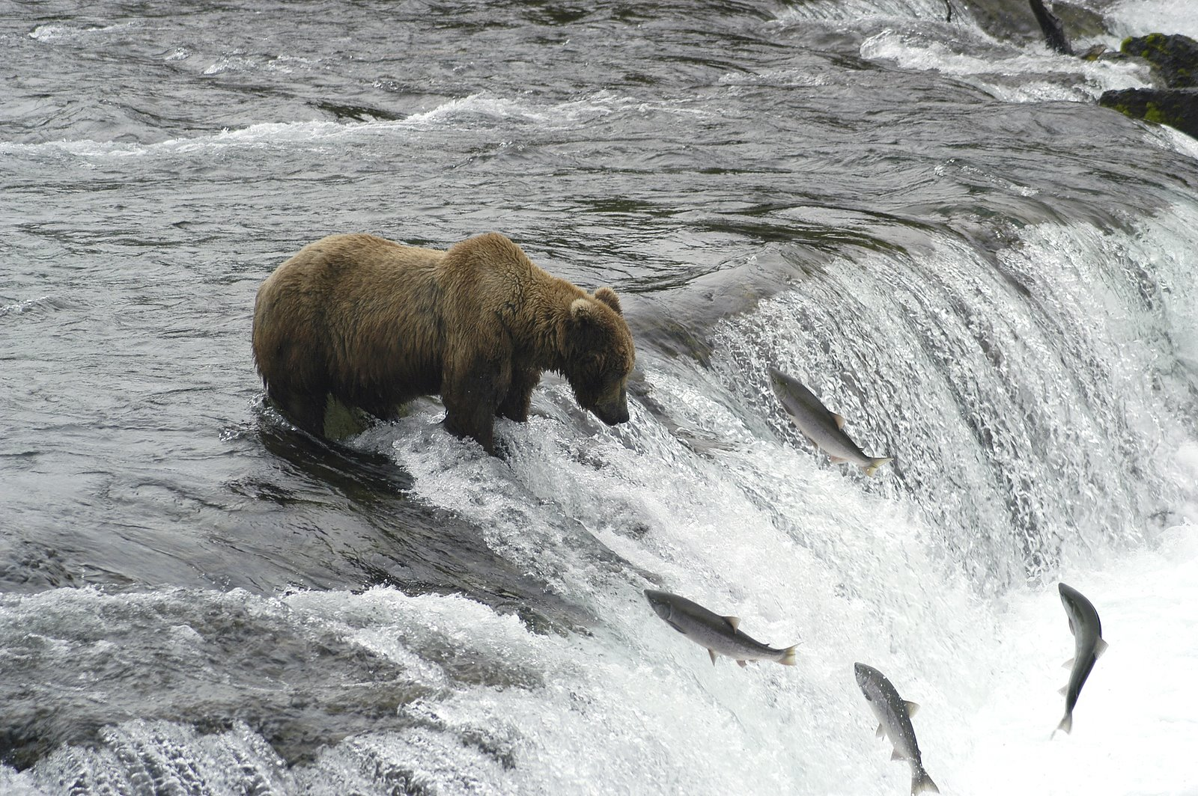
Notes:
And grizzly bears love eating salmon.

Slide 7
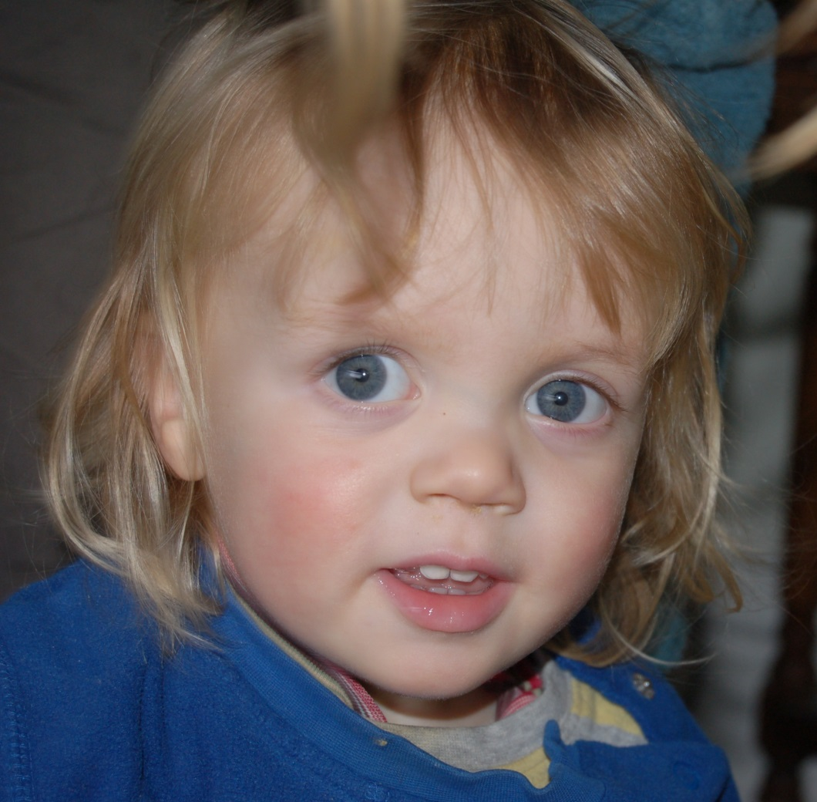
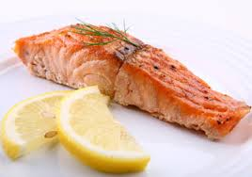
Notes:
As does George – in fact, it’s the only thing he eats (feel free to sway the picture of George with your own child, or yourself, or somebody else)

Slide 8
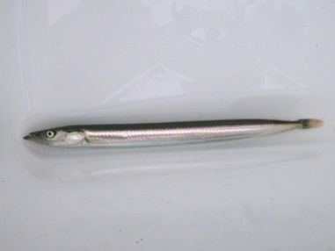
Notes:
So here we have a what? A food chain! Plankton to Copepod to Sandeel to Salmon to George

Slide 9
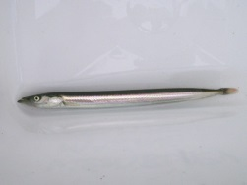
Notes:
Which we could represent as a pyramid of biomass – review why the blocks get smaller as you move up the pyramid – the idea of energy loss between trophic levels. Remember that George only eats salmon. So if George weights 20 kilos, and assuming a 90% loss of energy at each level, what mass of Plankton is needed to support this food chain? 200 tonnes! (200,000 kilos!!!!!)

Slide 10
Notes:
But what if you fed George on sandeels instead? What mass of Georges could this food chain now support?

Slide 11
Notes:
That 200,000 kilos of plankton could now feed 200 kilos of Georges…

Slide 12
Notes:
What if you removed the sandeels and fed him on copepods?

Slide 13
Notes:
The 200,000 kilos of Plankton can now feed 2000 kilos of Georges – 100 more people!

Slide 14
Notes:
And if we could somehow persuade George to subsist on plankton…?

Slide 15
Notes:
200,000 kilos of Plankton could support 20,000 kilos of Georges.

