Slide 1
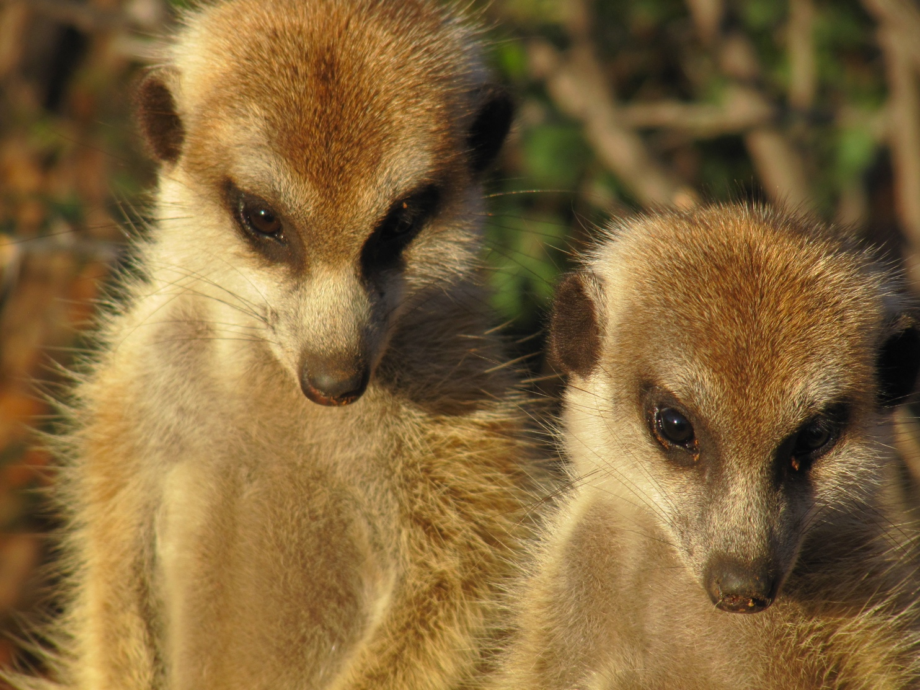
Sense and Sensibilities
Photo and resource by Jessica Mitchell

Slide 2
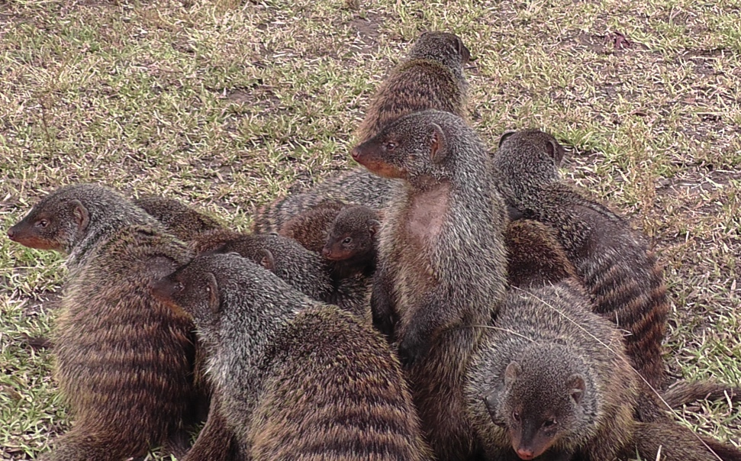
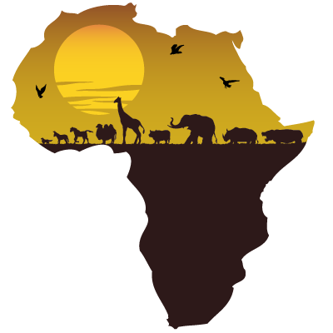
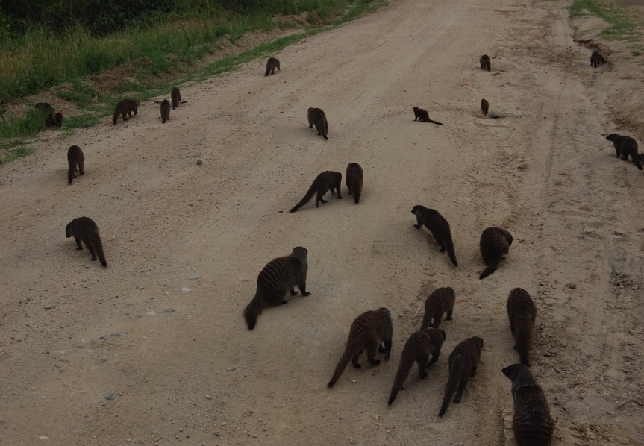
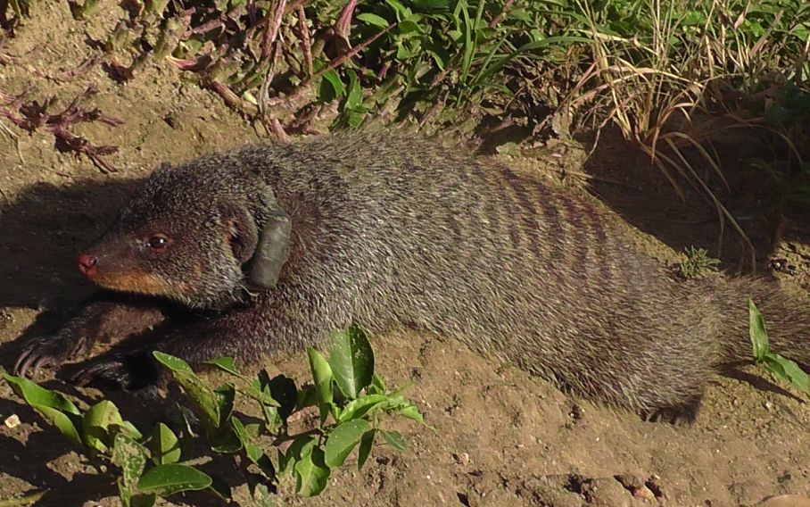
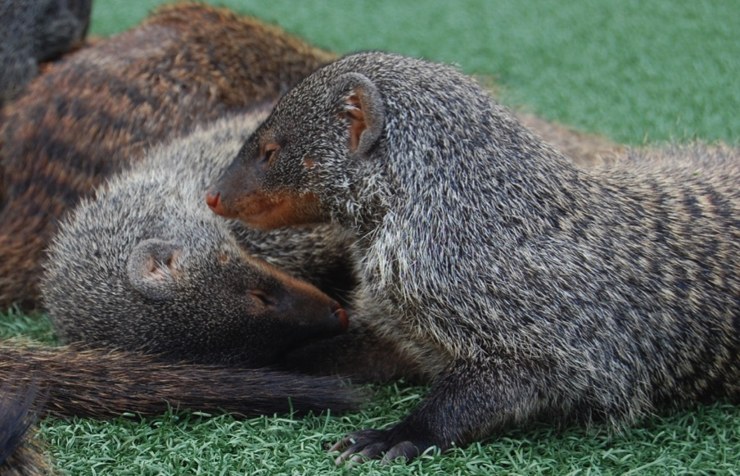
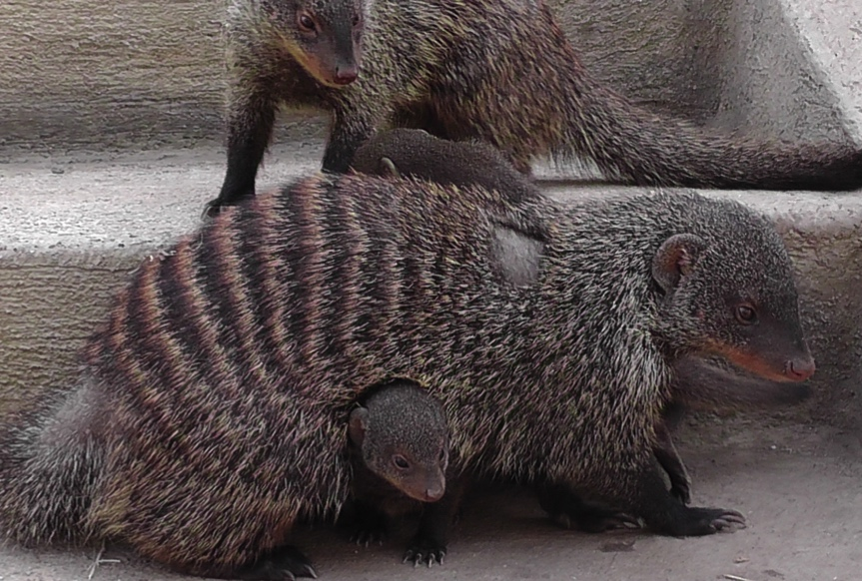
The Banded Mongoose

Slide 3
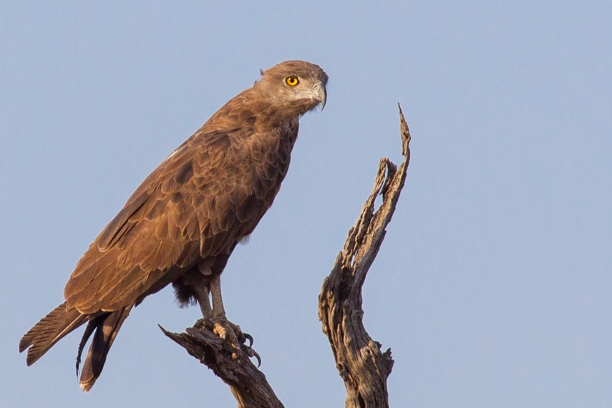
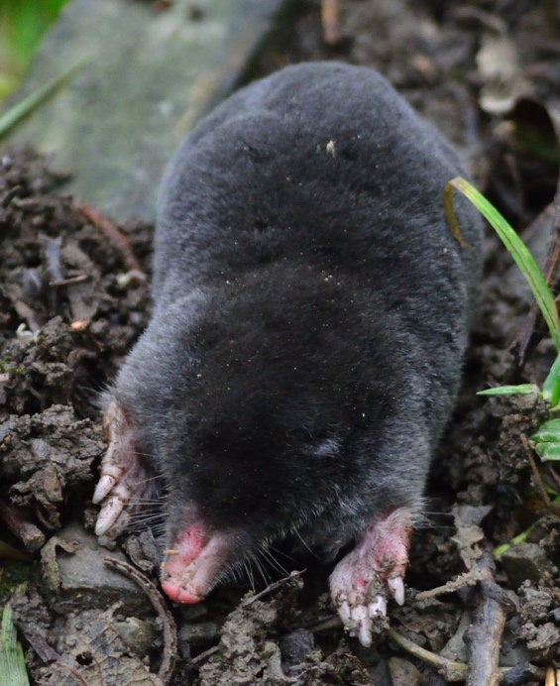
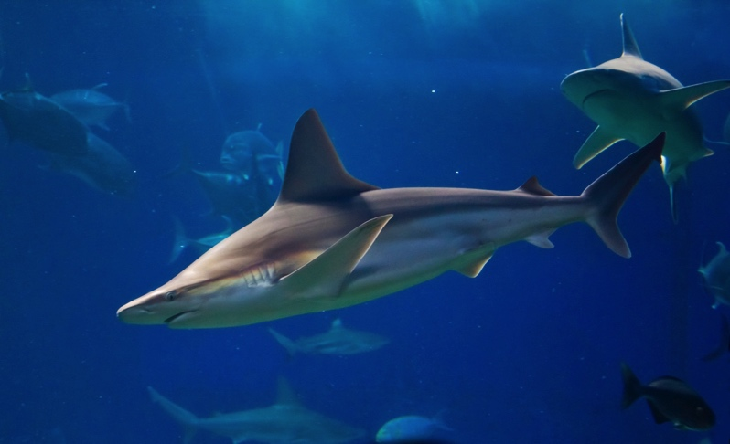
What senses are important to these animals?
Snake Eagle
Reef Shark
Honey Bee
Mole

Slide 4
Acknowledgements
The ASAB Education Committee would like to thank:
Jessica Mitchell (Liverpool John Moores University) for developing this resource and for all the banded mongoose photographs.
Also thanks go to the following
Mick Hoult (bee photograph)
Robert Muckley (snake eagle photograph)
Alex McLachlan (mole photograph)
Joe Boyd (shark photograph)

